Slide 1
R DATA STRUCTURES
Introduction to Data Science

Slide 2
R Data Structures
R has six types of basic data structures.
  Vectors
  Matrices
  Arrays
  Data Frames
  Factors
  Lists

Slide 3
Vectors
Vectors are one-dimensional arrays that can hold numeric data, character data, or logical data. The combine function c() is used to form the vector.
a <- c(1, 2, 5, 3, 6, -2, 4)
b <- c("one", "two", "three")
c <- c(TRUE, TRUE, TRUE, FALSE, TRUE, FALSE)

Slide 4
Vectors
Here, “hello world” is stored as a single character string. How can we store both the first and last name separately in a single object?
The function c() concatenates or combines single R objects into a vector of R objects.
Now what will be the length of the name variable? ( length(c) )
name <- "hello world"
name <- c("hello", "world")

Slide 5
Mathematical Operations using Vector
x <- c(2,4,6,8)
x * 3 # multiple each element of x by 3
Output: [1] 6 12 18 24
x + c(3,4,5,6) # add elements together in matching positions
Output : [1] 5 8 11 14
x <- c(2,4,6,8)
x + 2 # add 2 to each element of the vector x
Output : [1] 4 6 8 10
Notes:
Some examples of applications (potential or actual) are:
– a supermarket chain mines its customer transactions data to optimise targeting
of high value customers
– a credit card company can use its data warehouse of customer transactions
for fraud detection
– predicting the probability of default for consumer loan applications by improving
the ability to predict bad loans
– predicting the probability that a cancer patient will respond to chemotherapy,
thus reducing health-care costs without affecting quality of care.

Slide 6
Sort a Vector
To short a vector alphabetically or numerically , use the sort() function.
X <- c(20,10,40,15)
sort(X)
X
X <- c("B", "A", "D")
sort(X)

Slide 7
Access Vector
We can access the vector items by referring to its index number inside brackets[].
The first item has index 1 and second item has index 2 and so on.
X <- c(20,10,40,15)
X[1]
Output : [1] 20

Slide 8
Matrices
A matrix is a two-dimensional array where each element has the same mode (numeric , character, or logical). Matrices are created with the matrix() function.
Mymatrix <- matrix(vector, nrow = no_of_rows, ncol = no_of_columns, byrow = logical_value, dimnames = list(char_vector_rownames, char_vector_columnsnames))

Slide 9
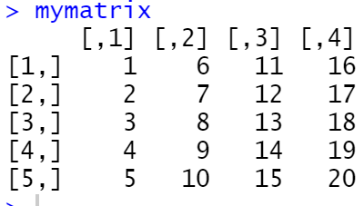
Matrices
Example: Creating matrices…
mymatrix <- matrix(1:20, nrow = 5, ncol = 4)

Slide 10
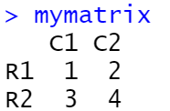
Matrix Filled by Rows
cells <- c(1:4)
rnames <- c("R1", "R2")
cnames <- c("C1", "C2")
mymatrix <- matrix(cells, nrow=2, ncol=2, byrow=TRUE, dimnames=list(rnames, cnames))
mymatrix

Slide 11
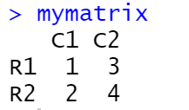
Matrix Filled by Columns
cells <- c(1:4)
rnames <- c("R1", "R2")
cnames <- c("C1", "C2")
mymatrix <- matrix(cells, nrow=2, ncol=2,
byrow=FALSE, dimnames=list(rnames, cnames))
mymatrix

Slide 12
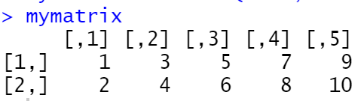
We can identify rows, columns, or elements of a matrix by using subscripts and brackets. X[i,] refers to the ith row of matrix X, X[,j] refers to jth column, and X[i, j] refers to the ijth element, respectively. The subscripts i and j can be numeric vectors in order to select multiple rows or columns, as shown in the following listing.
Matrix Filled by Columns
> mymatrix[2,]
[1] 2 4 6 8 10
> mymatrix[,2]
[1] 3 4
> mymatrix[1,3]
?
> mymatrix[1,c(2,3)]
?
mymatrix <- matrix(1:10, nrow=2, ncol=5)

Slide 13
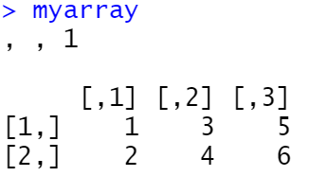
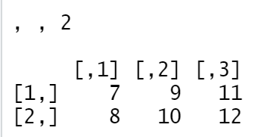
Arrays
Arrays are similar to matrices but can have more than two dimensions. They’re created with an array function of the following form:
myarray <- array(vector, dimensions, dimnames)
myarray <- array(1:24, c(2, 3, 2))
myarray

Slide 14
Access Array Items
You can access the array elements by referring to the index position. You can use the [] brackets to access the desired elements from an array:
myarray <- array(1:24, c(2, 3, 2))
myarray
myarray[1,2,1]
Output: [1] 3

Slide 15
Data Frames
A data frame is more general than a matrix in that different columns can contain different modes of data (numeric, character, etc.). It’s similar to the datasets you’d typically see in SAS, SPSS, and Stata. Data frames are the most common data structure you’ll deal with in R.
A data frame is created with the data.frame() function.
mydata <- data.frame(col1, col2, col3, …)

Slide 16
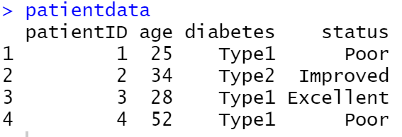
Data Frames
patientID <- c(1, 2, 3, 4)
age <- c(25, 34, 28, 52)
diabetes <- c("Type1", "Type2", "Type1", "Type1")
status <- c("Poor", "Improved", "Excellent", "Poor")
patientdata <- data.frame(patientID, age, diabetes, status)
patientdata

Slide 17
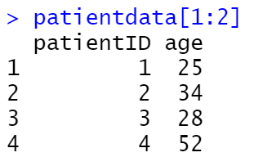
Specifying Elements of a Data Frame
There are several ways to identify the elements of a data frame. You can use the subscript notation you used before (for example, with matrices) or you can specify column names.

Slide 18
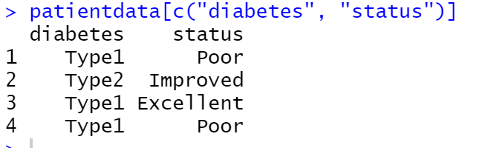
Specifying Elements of a Data Frame
patientdata[c("diabetes", "status")]

Slide 19
Factors
Factors are the data objects which are used to categorize the data and store it as levels.
To create a factor , use the factor() function and add a vector as argument.
students_cgpa <- factor(c("A","A+","B","C","B","C"))
students_cgpa
[1] A A+ B C B C
Levels: A A+ B C

Slide 20
List
Lists are the most complex of the R data types.
Basically, a list is an ordered collection of objects (components).
A list allows you to gather a variety of (possibly unrelated) objects under one name.
For example, a list may contain a combination of vectors, matrices, data frames, and even other lists.
We create a list using the list() function.
mylist <- list(object1, object2, …)

Slide 21
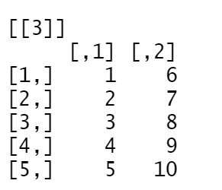
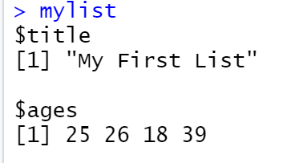

List
g <- "My First List"
h <- c(25, 26, 18, 39)
j <- matrix(1:10, nrow=5)
k <- c("one", "two", "three")
mylist <- list(title=g, ages=h, j, k)

Slide 22
Access List
mylist[[2]]
[1] 25 26 18 39

Slide 23
Add List Items
  To add an item to the end of the list use the append() function
  To add an item to the right of a specified index add “after=index number” in the append function.
item <- list("mango", "apple")
append(item, "orange")
item <- list("mango", "apple")
append(item, "orange", after=1)

Slide 24
Remove List Items
  If we want to remove mango from the list…..
item <- list("mango", "apple")
newitem <- item[-1]

Slide 25
Summary
Any questions?

